Slide 1

EMERGENCY ROOM PRIORITY HANDLING SYSTEM
USING HEAPS
A CAPSTONE PROJECT
CSA0315 DATA STRUCTURES
Supervisor Dr. T Rajesh Kumar , Professor, Department of CSE, Saveetha School of Engineering.
PRESENTED BY D. HOSHEA PAUL (192471019)
NANDHA KRISHNA V (192524012)

Slide 2
ABSTRACT
• Registers emergency-room patients and assigns priority from emergency level.
• Stores patient records in a heap-based priority queue for efficient scheduling.
• Highest-priority patients are selected first and removed after treatment.
• Maintains waiting-list updates, treatment status, statistics, and daily reports.
• Includes three modules covering registration, heap scheduling, and treatment/reporting.
PATIENT ENTRY
Patient ID • Age • Symptoms
PRIORITY
Emergency level → Heap
MAX-HEAP PRIORITY QUEUE
1
2
3
4
5
6
7

Slide 3
PROBLEM IDENTIFICATION
• Emergency patients cannot be scheduled efficiently using simple FIFO ordering.
• Critical cases must be identified and served before lower-priority cases.
• Manual priority handling can cause incorrect ordering and increased waiting time.
• Patient records, treatment status, waiting lists, and reports must remain consistent.
• A data-structure-based solution is required for fast priority insertion and removal.
MAX-HEAP PRIORITY QUEUE
1
2
3
4
5
6
7
Goal: correct treatment order with efficient priority handling.

Slide 4
OBJECTIVES
1. To implement emergency patient scheduling using a Max Heap.
2. To assign priorities based on medical emergency levels.
3. To perform efficient priority queue operations.
4. To implement patient lookup using a Hash Table with Linear Probing.5. To develop a menu-driven Emergency Department system in C.

Slide 5
INTRODUCTION
An emergency room must treat patients according to urgency rather than simple arrival order. A priority queue keeps the most critical patient at the front of the treatment schedule.
This project uses a heap to implement that priority queue and demonstrates registration, priority assignment, scheduling, treatment updates, and reporting through a structured C application.
REGISTER
Patient details
PRIORITIZE
Emergency level
SCHEDULE
Highest priority first
REPORT
Waiting time + statistics

Slide 6
SYSTEM ARCHITECTURE
PATIENT REGISTRATION
TREATMENT MANAGEMENT
ID • Age • Symptoms
Mark treated + remove
MAX-HEAP PRIORITY QUEUE
Insert • Heapify • Delete highest priority
PRIORITY ASSIGNMENT
REPORTING & STATISTICS
Emergency level + validation
Waiting time • Priority counts • Daily report

Slide 7
MODULE 1 : PATIENT REGISTRATION AND PRIORITY ASSIGNMENT
PATIENT RECORD
• Register patient details and assign a unique Patient ID.
• Record patient age and symptoms.
• Assign priority based on emergency level.
• Store validated patient information for scheduling.
• Display patient details for confirmation.
ID • Age • Symptoms • Priority
EMERGENCY LEVEL
CRITICAL
HIGH
MODERATE

Slide 8
MODULE 2 : HEAP-BASED EMERGENCY PRIORITY SCHEDULING
• Insert each patient into the heap using priority.
• Rearrange the heap using heapify after insertion.
• Delete the highest-priority patient after treatment.
• Update the waiting list and display the current queue.
• Support fast patient retrieval and scheduling.
INSERT
HEAPIFY
DELETE
Add patient
Restore order
Serve patient
MAX-HEAP PRIORITY QUEUE
1
2
3
4
5
6
7

Slide 9
MODULE 3 : TREATMENT MANAGEMENT, REPORTING AND STATISTICS
TREATMENT
• Mark patient as treated and remove the patient from the heap.
• Display a daily emergency report.
• Calculate average waiting time.
• Count patients by priority level.
• Save reports into a text file for permanent history.
Mark treated + remove
STATISTICS
Waiting time + priority counts
REPORT
Generate + save daily report

Slide 10
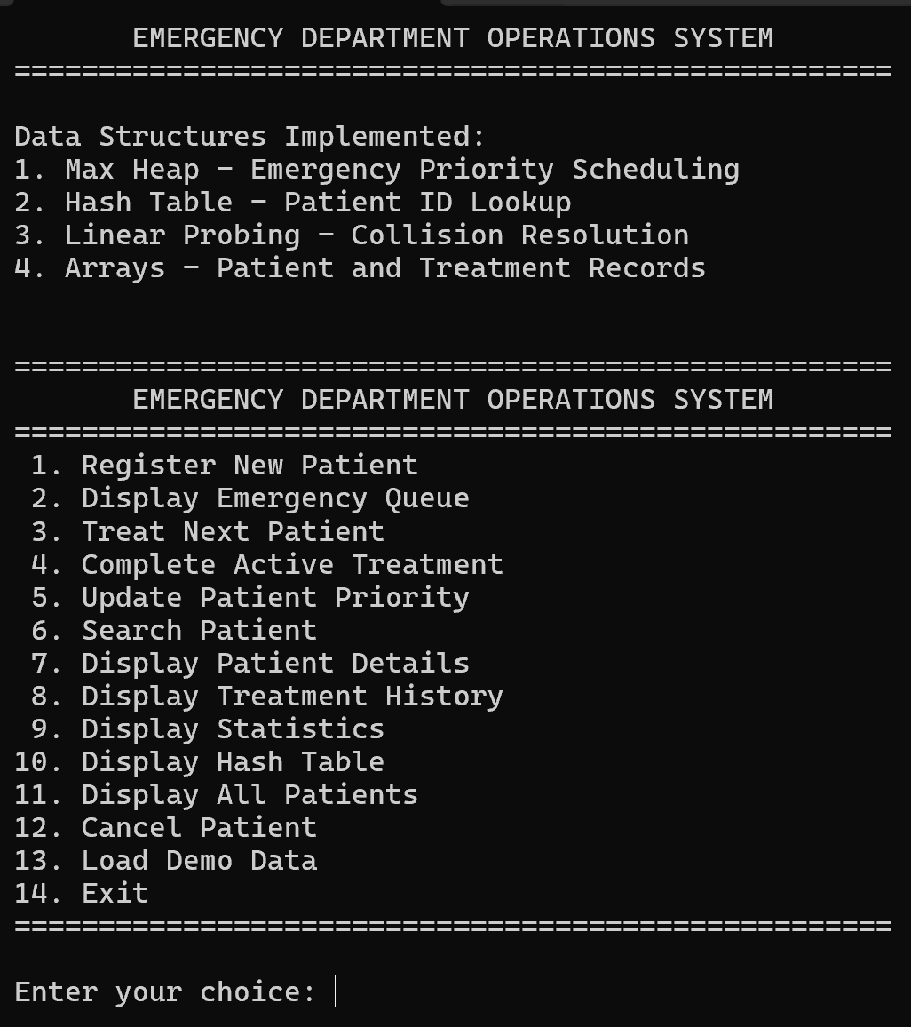
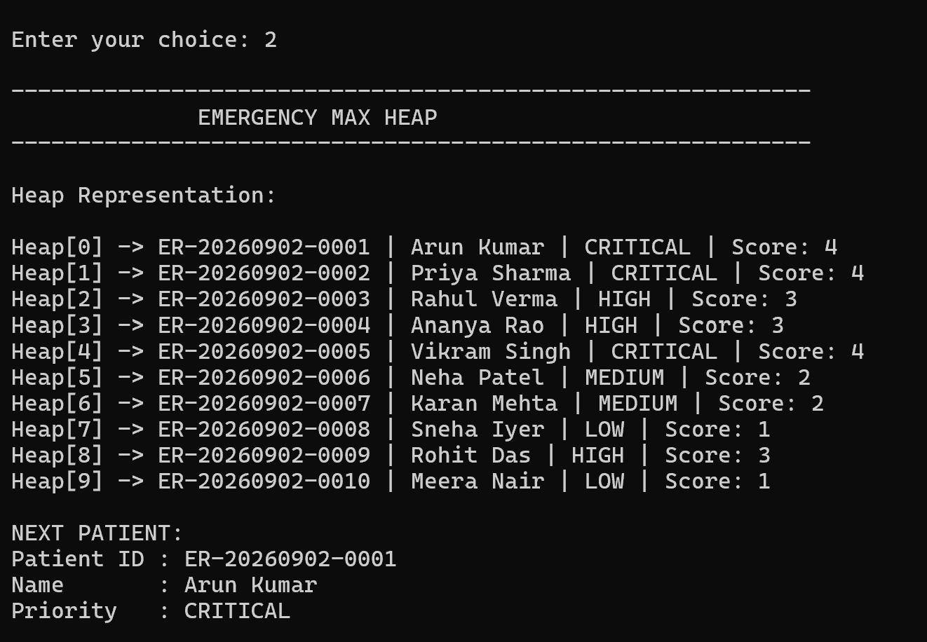
RESULT
Fig 2 Emergency Max Heap
Fig 1 Dashboard

Slide 11
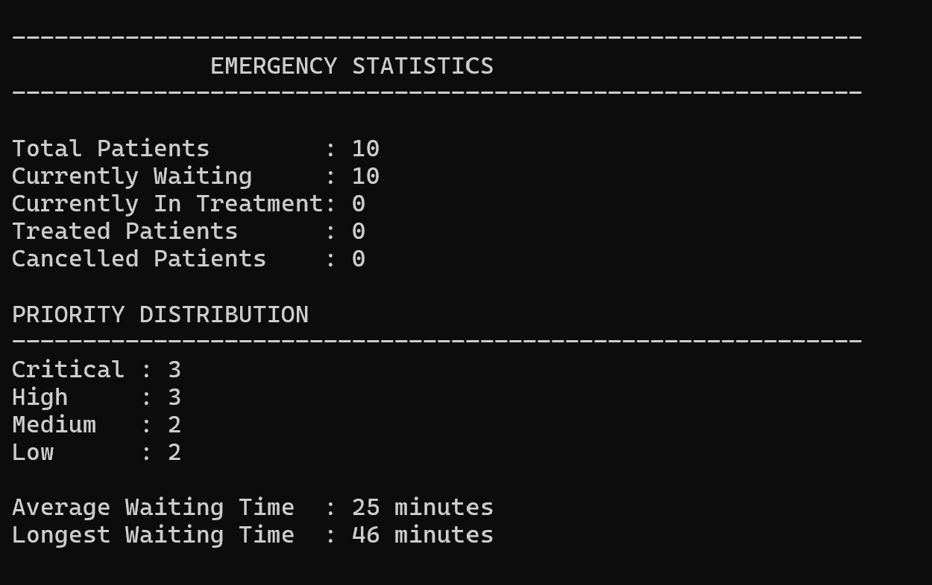
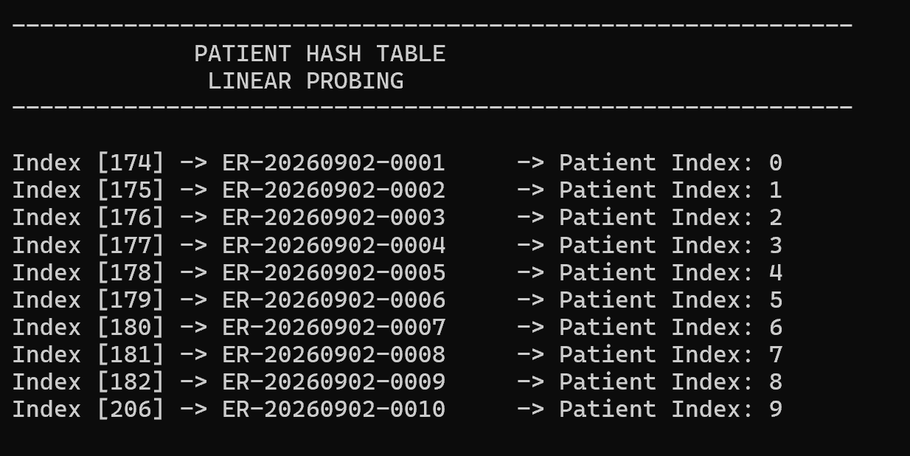
RESULT
Fig 3 Emergency Statistics
Fig 4 Hash Table

Slide 12
CONCLUSION
• Patient information is registered, validated, and assigned an emergency priority.
• A heap-based priority queue maintains the correct treatment order efficiently.
• Highest-priority patients are selected first and removed after treatment.
• Waiting-time statistics, priority counts, and daily reports provide useful operational summaries.
• The project demonstrates how heaps and fundamental C data structures can improve emergency-room scheduling.

Slide 13
FUTURE ENHANCEMENTS
• Add dynamic priority adjustment when a patient's condition changes.
• Support multiple treatment rooms and resource allocation.
• Add graphical waiting-time and priority-distribution charts.
• Integrate persistent database storage instead of text-only history.
• Extend the system with real-time alerts and a more advanced user interface.

Slide 14
REFERENCES
Gilboy, N., Tanabe, P., Travers, D., Rosenau, A. M., & Eitel, D. R. (2012). Emergency Severity Index (ESI): A triage tool for emergency department care, Version 4: Implementation handbook. Agency for Healthcare Research and Quality. GovInfoEmergency Nurses Association. (2023).
Emergency Severity Index handbook (5th ed.). Emergency Nurses Association.
(2026). Lecture 18: Heaps and priority queues. Cornell University. �Cornell Computer ScienceJames Madison University. (2018).
Heaps and priority queues. OpenDSA.. (2025). Priority queues. Department of Computer Science, Princeton University.

Slide 15


